Slide 1
Simulation
Stochastic modeling

Slide 2
Random objects
Random events
Random variables
Random processes
Random point processes

Slide 3
Random point processes (random flows or streams)
simulation

Slide 4
Random point process
interarrival (period)
interval between two subsequent events
time
arrivals
event occurrences
Modeling:
Starting point is given. Model interval until next event occurs, and so on…

Slide 5
Poisson point process (PPP)
- definitions
1. By features
2. By distribution
Independence: event occurrences are independent of each other.
Ordinarity: only single event may occurs at a time moment.
Stationarity: the number of event occurrences in some interval does not depend on the interval starting point.
The number of event occurrences in some time interval with length t is distributed according to Poisson distribution:
This number is completely independent of all the other intervals that are disjoint with considering one.
λ is an intensity of event occurrence = intensity of arrivals = intensity of the process (PPP),
intensity = rate
Probability of event occurrence during interval Δt:

Slide 6
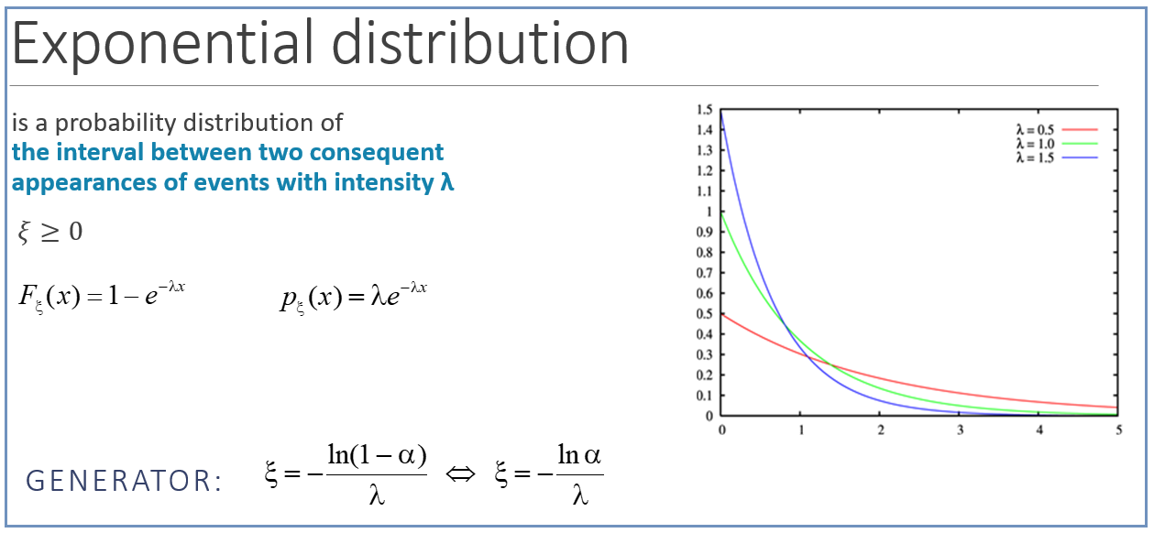
Poisson point process - modeling
Main property of PPP interarrivals
they are all distributed according to Exponential Distribution Law:
PPP MODELING:
t₀ is given
Main property of exponentially distributed interarrivals
you can choose arbitrary point on the time axis during PPP evolution, the residual time will be distributed exponentially with the same parameter λ.

Slide 7
Non-stationary Poisson point process
Stationary PPP:
Independence: event occurrences are independent of each other.
Ordinarity: only single event may occurs at a time moment.
Stationarity: the number of event occurrences in some interval does not depend on the interval starting point.
+ probability of event occurrence
during interval [t; t + Δt]:
non-stationary Poisson point process

Slide 8
Non-stationary Poisson point process
MODELING

Slide 9
Markov modulated Poisson Process (MMPP)
- conditional intensities
Continuous-time Markov chain with generator matrix Q
underlying Markov chain

Slide 10
MMPP
MODELING

Slide 11
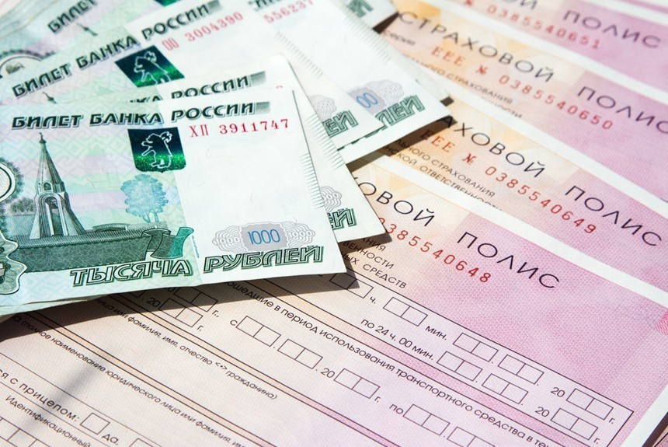
Laboratory #12
Assignment:
Insurance company
Flows of incoming customers and insurance cases should be modeled.
Insurance payment is greater than a price of insurance but insurance cases appear less often than customers’ arrivals.

